Slide 1
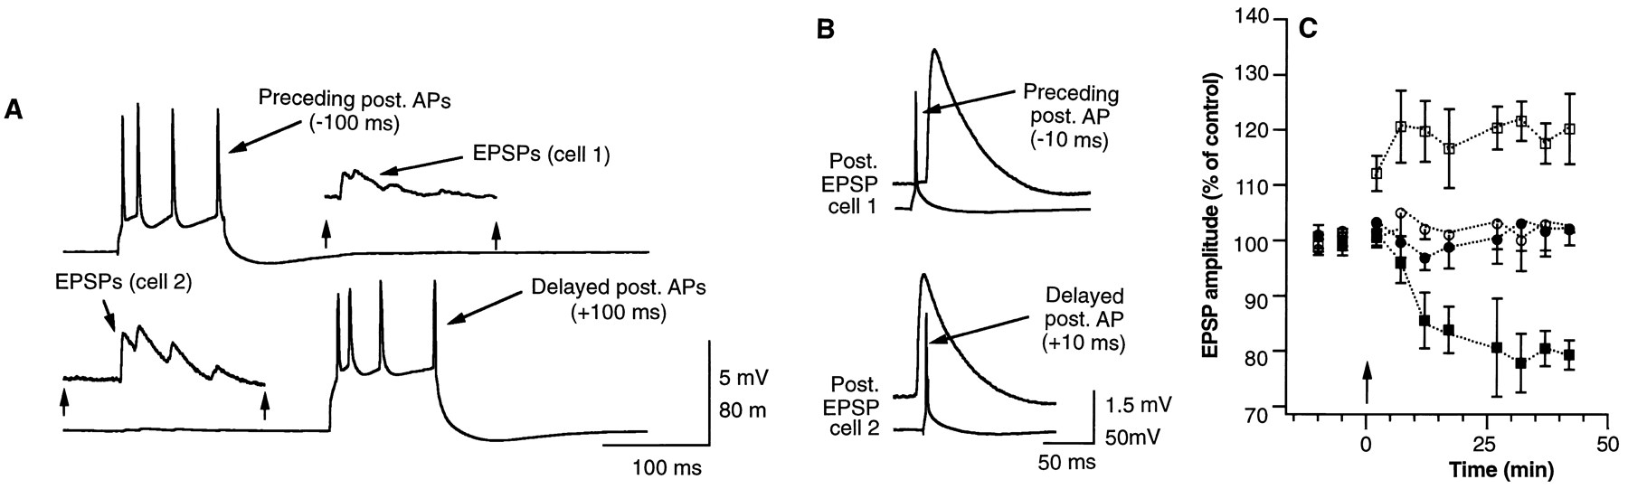
Spike timing dependent plasticity - STDP
Post before Pre: LTD
+10 ms
Pre before Post: LTP
-10 ms
Markram et. al. 1997
Notes:
1

Slide 2
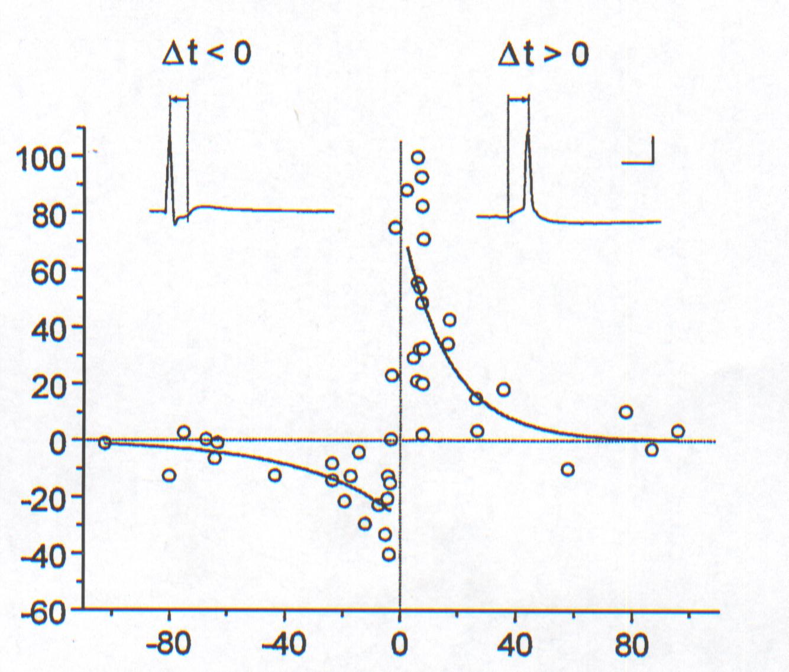
Spike Timing Dependent Plasticity: Temporal Hebbian Learning
Causal
(possibly)
Synaptic
change %
Pre
Post
t_{Pre}
t_{Post}
Post
Pre
Acausal
Pre precedes Post:
Long-term
Potentiation
t_{Pre}
t_{Post}
Pre follows Post:
Long-term
Depression
Weight-change curve (Bi&Poo, 2001)

Slide 3
Overview over different methods
You are here !

Slide 4
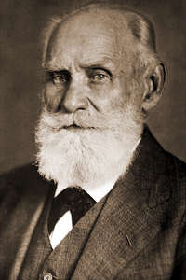
History of the Concept of Temporally
Asymmetrical Learning: Classical Conditioning
I. Pawlow

Slide 5
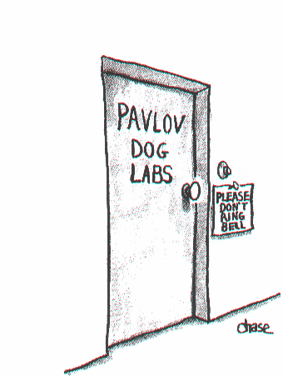

Slide 6
History of the Concept of Temporally
Asymmetrical Learning: Classical Conditioning
Correlating two stimuli which are shifted with respect to each other in time.
Pavlov’s Dog: “Bell comes earlier than Food”
This requires to remember the stimuli in the system.
Eligibility Trace: A synapse remains “eligible” for modification for some time after it was active (Hull 1938, then a still abstract concept).
I. Pawlow

Slide 7
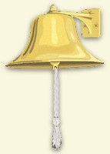

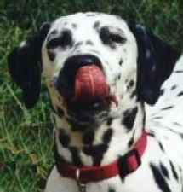
Classical Conditioning: Eligibility Traces
Conditioned Stimulus (Bell)
X
Stimulus Trace E
Δω₁
+
ω₁
Σ
Σ
Response
ω₀ = 1
Unconditioned Stimulus (Food)
The first stimulus needs to be “remembered” in the system

Slide 8
History of the Concept of Temporally
Asymmetrical Learning: Classical Conditioning
Eligibility Traces
Note: There are vastly different time-scales for (Pavlov’s) behavioural experiments:
Typically up to 4 seconds
as compared to STDP at neurons:
Typically 40-60 milliseconds (max.)
I. Pawlow

Slide 9
Overview over different methods
Mathematical formulation of learning rules is similar but time-scales are much different.

Slide 10

Differential Hebb Learning Rule
V’(t)
Simpler Notation
x = Input
u = Traced Input
x
X_{i}
ω
u_{i}
V
Early: “Bell”
Σ
X₀
u₀
Late: “Food”

Slide 11
Defining the Trace
In general there are many ways to do this, but usually one chooses a trace that looks biologically realistic and allows for some analytical calculations, too.
EPSP-like functions:
α-function:
k
Shows an oscillation.
Dampened
Sine wave:
k
Double exp.:
k
This one is most easy to handle analytically and, thus, often used.

Slide 12
Defining the Traced Input u
u
w
Convolution used to define the traced input,
Correlation used to calculate weight growth (see below).

Slide 13
Defining the Traced Input u
u
Specifically (we are dealing with causal functions!):
If x is a spike train
(using the δ-function):
Then:
For example:

Slide 14
Differential Hebb Rules – The Basic Rule
The basic rule: ISO-Learning
General:
Two inputs only. Thus
we get for the output:
One weight unchanging:
w₀=1=const.
ISO rule
Same h for all inputs.
Isotropic Sequence Order Lng.
(as we can also allow w₀ to change!)

Slide 15
Differential Hebb Rules – More rules (but why?)
ICO - Learning
ISO3 - Learning
ICO
ISO3
Input correlation Learning
Three factor learning
(as we take the derivative of the
unchanging input u₀)
The denotes that we are only
using positive contributions

Slide 16
Stability Analysis
Inputs
X₁
X₀
x
X₁
ω
u₁
V
Σ
X₀
u₀
CC
AC

Slide 17
Stability Analysis
Desired contribution
Undesired contribution
Some problems with these differential equations:
1) As we are integrating to ∞ strictly we need to assume that there is no second pulse pair coming in “ever”.
2) Furthermore we should assume that w₁’→0 (hence μ small) or we get second order influences, too.

Slide 18
Stability Analysis (ISO)
Under these assumptions we can calculate Δw^{AC} and Δw^{CC} to find out whether the rules are stable or not.
In general we assume two inputs:
T
and
Inputs
X₁
X₀
and get for ISO:
ISO is (only) asymptotically stable for t→∞

Slide 19
Stability Analysis for pulse pair inputs (ISO)
Setting x₀=0
Single pairing
relaxation behavior
w₁
Δw
Magn. of one step
Notice the AC
contribution
t
This shows that early arrival of a new pulse pair might easily fall into a not fully relaxed system. (Instable !)
The remaining upward drift is only due to the AC term influence (Instable !)

Slide 20
Learning Window (weight change curve)
ISO: Weight change curve
Compare to STDP
The weight change curve plots Δw in dependence on the pulse pairing distance T in steps, where we define T>0 if the x₁ signal arrives before x₀ and T<0 else.

Slide 21
Stability Analysis: Compare ISO with ICO
The basic rule: ISO-Learning
ICO - Learning
ISO rule
ICO
Input correlation Learning
(as we take the derivative of the
unchanging input u₀)
Notice the difference

Slide 22
Stability Analysis: ICO
Same as for ISO!
Δw
Fully stable !
No more drift!
Single pulse pair
(no more AC term in ICO).
ISO
ICO
t
ICO: Weight change curve
(same as for ISO)

Slide 23
Stability Analysis: More comparisons
The basic rule: ISO-Learning
ICO - Learning
ISO rule
ICO
Conjoint learning-control-
signal (same for all inputs !)
Single input as designated learning-control-signal.
Makes ICO a heterosynaptic rule of questionable biological realism.

Slide 24
Stability Analysis: More comparisons
This difference is especially visible when wanting to symmetrize the rules (both weights can change!).
ICO-Sym
Two
control
signals !
ISO-Sym One control signal !

Slide 25
The Effects of Symmetry
T
Inputs
X₁
X₀
Synapse w₁ grows because x₁ is before x₀.
Synapse w₀ shrinks because x₀ is after x₁.
ICO-sym is truly symmetrical, but needs two control signals.
ISO-sym behaves in a difficult and unstable oscillatory way.

Slide 26
ISO3: uses – like ISO – a single learning-control-signal
Idea: The system should learn ONLY at that moment in time when there was a “relevant” event r !
ISO3 - Learning
We use a shorter trace for r, as it should remain rather restricted in time.
Same filter function h but parameters a_{r} and b_{r}.
We also define T_{r} as the
ISO3
interval between x₁ and r. Many times T_{r}=T, hence r occurs together with x₀.

Slide 27
Stability Analysis: ISO3
Observations:
Cannot be solved anymore!
AC term is generally NOT equal to zero.
Not even asymptotic convergence can be generally assured.
So what have we gained ?
One can show that for T_{r}=T the AC term vanishes if v has its maximum at T.

Slide 28
Stability Analysis: ISO3, graphical proof
T
as x₀ has not yet happened
Contributions of AC and CC
graphically depicted
Maximum at T
If we restrict learning to the moment when x₀ occurs then we do not have any AC contribution.
!! A questionable assumption: argmax(u₁) = T !!

Slide 29
Stability Analysis: ISO3
Δw
No more upwards drift for ISO3
Single pulse pair
(ISO3 is stable and relaxes
instantaneously).
ISO
ISO3
t
Weight change curve
(no more STDP!)

Slide 30
A General Problem: T is usually unknown and variable
Introducing a filter bank: (example ISO)
Spreading out the earlier input over time!
Remember: “A questionable assumption: argmax(u₁) = T”

Slide 31
Stability Analysis: ISO3 with a filter bank
With a filter bank we get for the output:
Original Rule was:
Single weights develop now as:
CC
AC
With delta-function inputs at t=0 and t=T we get:
It is possible to prove that this term becomes zero as a consequence of the learning!

